Slide 1
LLM Chat App
Screencast explaining the codebase

Slide 2
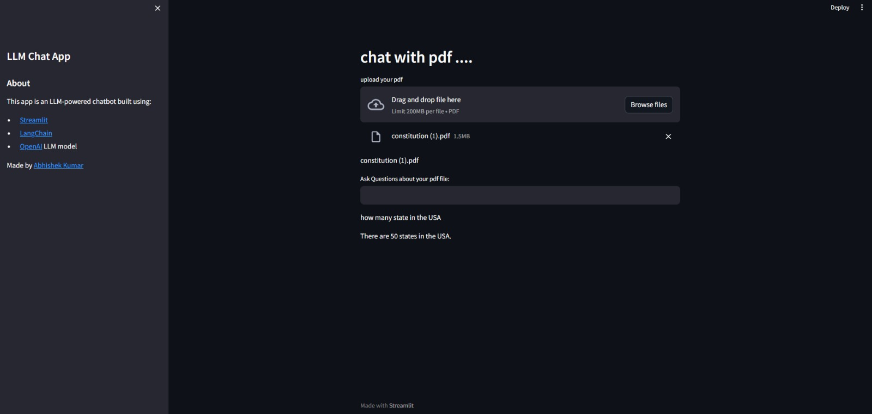
User Interface -
The right side of the screen in this UI design displays information about the application and the user's name. Additionally, the option to upload a PDF and its name are displayed on the main screen, and a question-answer bar is displayed beneath this.

Slide 3
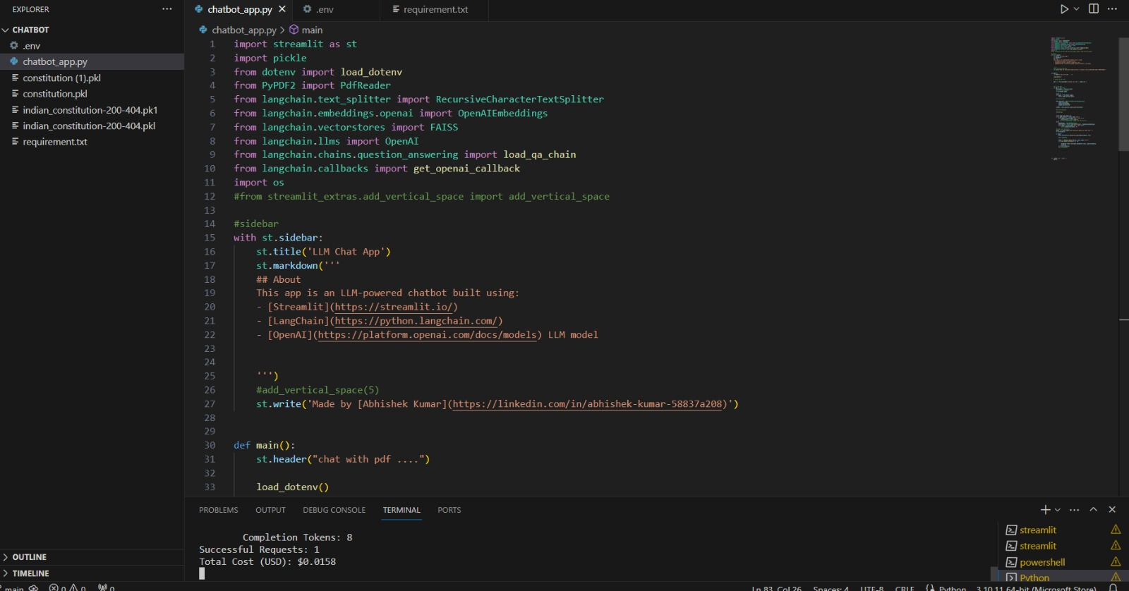
Explanation of the code
I used the streamlit library to produce this work. You are aware that the Streamlit library is an open-source, free platform for developing and sharing beautiful data science and machine learning web apps. The library was developed using Python with machine learning engineers in mind. I used several Python modules, such as PyPDf, Langchain, OpenAI, dotenv, faiss, and embedding. With PyPDF, I read the full PDF file, extracted all the content, and put it all into a variable. The variable was then split up into several parts using RecursiveCharacterTextSplitter. To speed up processing, each chunk contains some overlapping data. Chunks are simply short variables that store data.

Slide 4
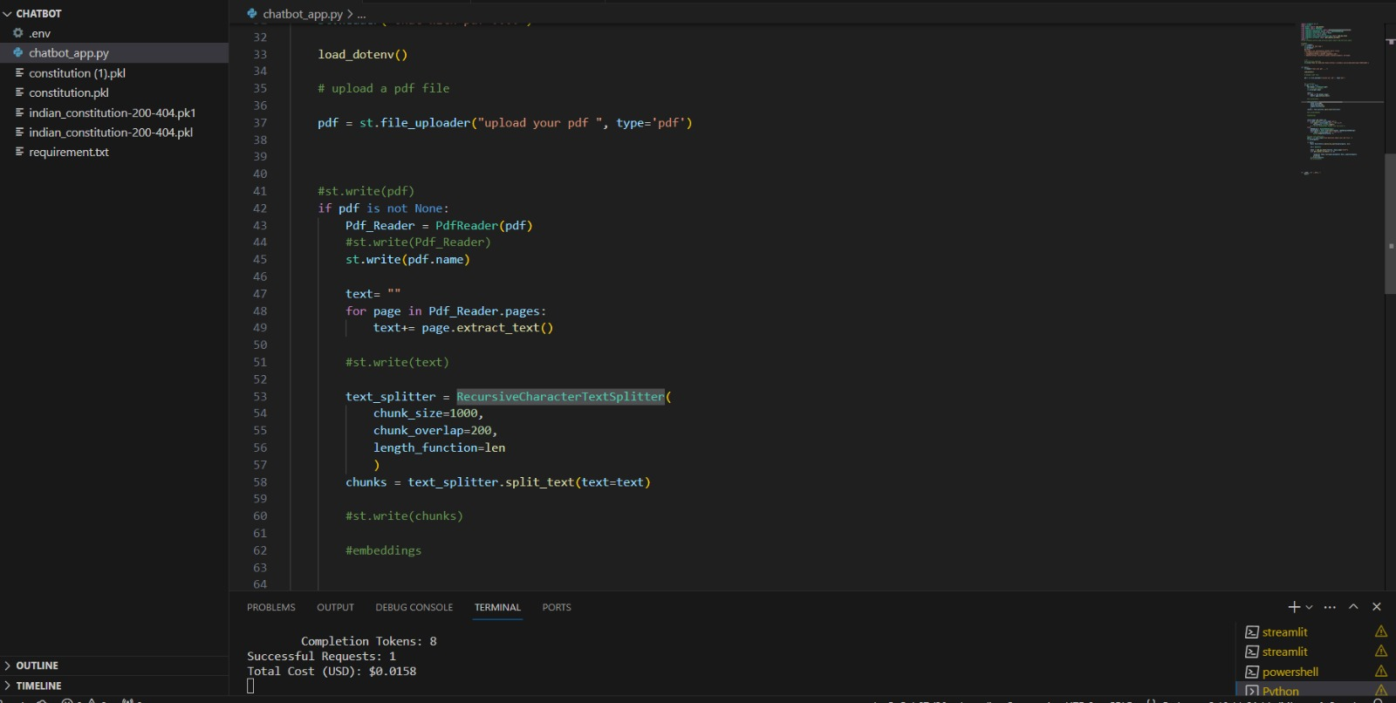

Slide 5
Following that, the FAISS's OpenAIEmbeddings() function is used to embed each chunk. As you are aware, an embedding is a translation of high-dimensional vectors into a comparatively low-dimensional space. Machine learning on big inputs, such as sparse vectors representing words, is made easier with the help of embeddings. after that, using pickle.dump to generate a semantic index. Now that I've entered a user query, the API uses it to incorporate the user's query and perform a semantic search. I then utilized LLM generative AI to rank the outcome after all of these and provide the output

Slide 6
End

